Slide 1
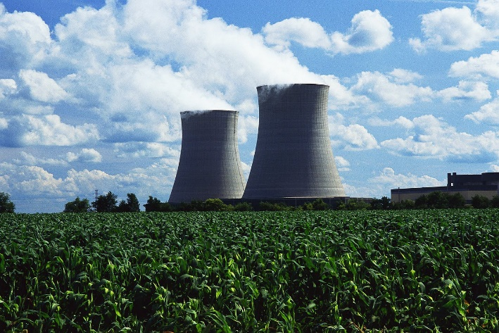

Real-Time Prognostic Analysis Systems: Monitoring and Damage Mitigation
David Greene [GRDI]
Tristan Seroff [GRDI]
Preston Johnson [NI]
August 7th, 2013
Notes:
Preface:
Most power plants have two major components; a fossil fuel or nuclear reactor heater and an attached steam generator. The steam generator boils water to produces steam that drives a turbine and generate electricity.
Electric power is sold under contract to a utility who then passes the power into the national electrical grid.

Slide 2
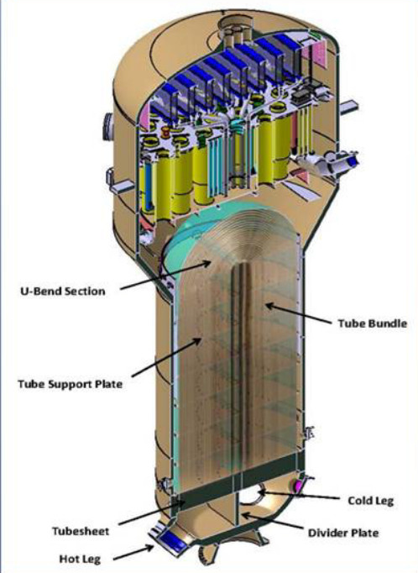
Problem: SONGS Steam Generator
  Tube vibration/wear
    Undetected during ~20 months of operation
      ~1,500 out of ~10,000 tubes damaged
  Outcome:
    Replacement energy costs - $1.5M/day
    Nuclear power plant abandoned
  Major $$ impact (e.g. 59% higher power cost)
  Loss of confidence: NRC/Public
Notes:
The plant owner can make lots of money when the plant is operational. However, if the power plant shuts down the utility under their contract then charges the plant owners to buy replacement electrical energy for the grid. The cost of just the replacement electric power was 1.5 Million dollars per day! ($0.5B/year).
Steam generators are the Achilles heel for the power plant owners, not in just nuclear plants but also fossil fuel plants. It is a generic problem.
B. The recent permanent closure of the San Onofre Nuclear Generation Station [SONGS] in Southern California was caused by steam generator tube vibration and associated tube wear (fretting damage).
C. Southern California Edison states in an official report. [AB 1632] “Overall, SONGS (2 & 3 operations) directly and indirectly supported approximately 9,400 jobs, and positively impact the California economy by more than $3.3 billion per year”.
The plant’s owners, Southern California Edison, have recently surrendered their NRC operating licenses. Fuel has been removed, and plant will be abandoned. Closure of the SONGS nuclear power plant has caused a serious economic impact not only on the local area, but impacted several adjacent states who relied upon the base power provided by the station. Consequently, the wholesale cost of electricity increased significantly, a 59% increase in wholesale electricity costs in Southern California and ~15% increase in California electricity bills.
To summarize:
The vibration problem that closed the SONGS plant was not detected during almost two years of power operation.
The SONGS problem could have been prevented if the steam generators had installed a GRDI-NI BatScan system. BatScan detects vibration within a few seconds with very low false alarm rates (i.e. once or twice in the plant 30-year lifetime)
We’re going to use this steam generator vibration problem as an example to describe how GRDI and NI’s technologies are working symbiotically to provide a solution to real-life problems such as those faced by the nuclear industry.

Slide 3
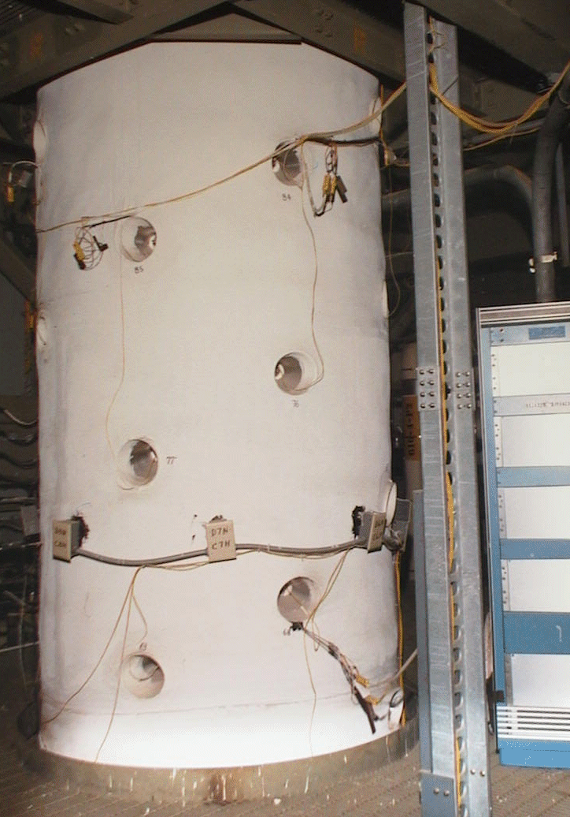
Solution: Fault Detection and Location Monitor
  Steam Generator, Reactor, Turbine
  Monitoring requirements:
    Reliable [timely, accurate, dependable]
    3-D monitoring and damage mitigation
      Non-invasive during all plant operations
      Automatic entry into prognostic database
    Operator training capabilities
Notes:
This slide lists major requirements to successfully monitor steam generators and other critical components in nuclear power plants.
Of the requirements listed, the most important is reliability, since this impacts plant safety, efficiency and especially operator confidence.
BatScan was designed to meet or exceed these extremely demanding system performance criteria.

Slide 4
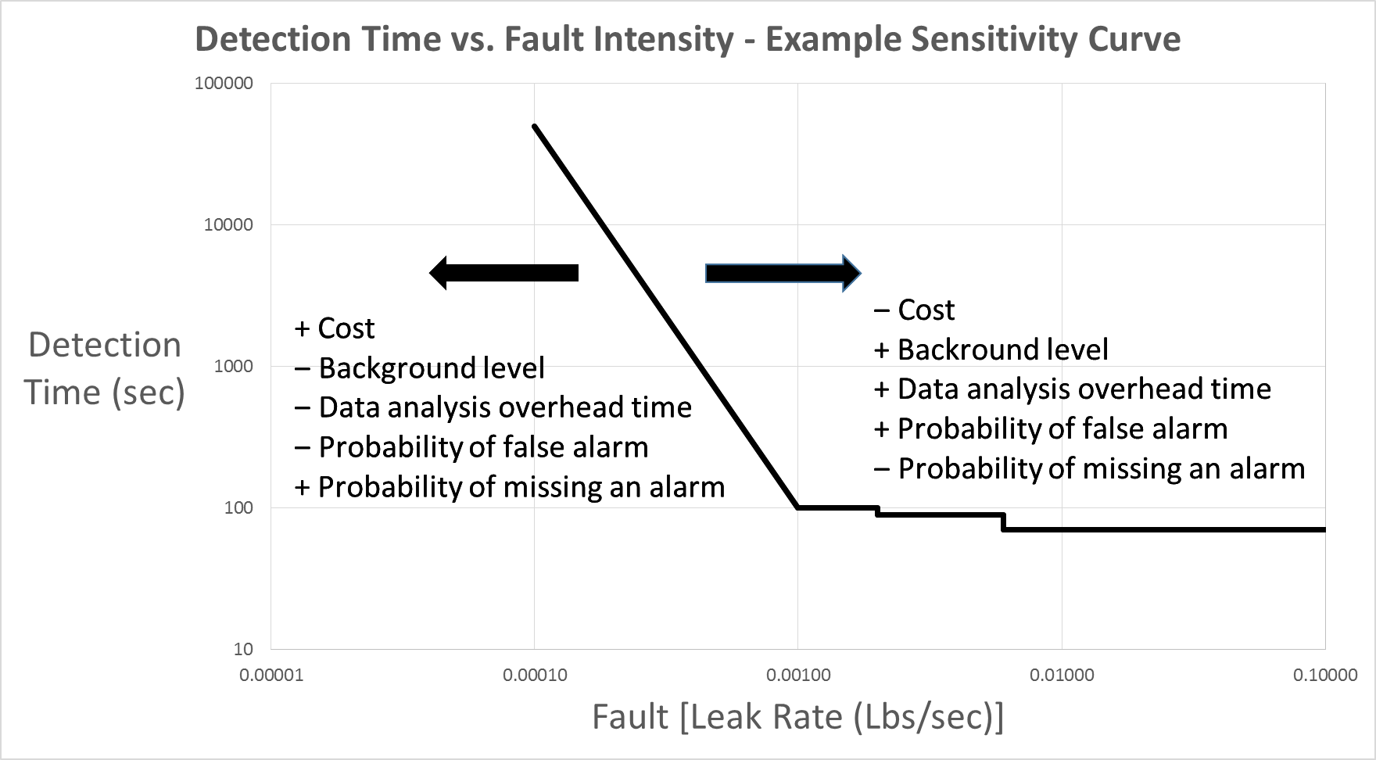
Typical specifications for NPP BatScan
  <1 False alarm per 30 year period
  Detection times within ~2 seconds
  Absolute measure; S/N ratio < -25dB
  Locates to within radius of ~5 cm
Fully Verified & Validated Solution
Notes:
The detailed criteria listed were specified by the Customer to protect their steam generator during operation at full power: That is:
A. Measurement of fault with a S/N ratio of < -25dB
B. Cause less than one(1) false alarm per 30 years of plant operation
C. Detection and location of faults within two (~2) seconds
D. Location of the fault to within a radius of ~5 cm
Extensive R&D programs allowed these criterion to be achieved; outcome resulting in:
A. verified performance with customer approval, and
B. provided a validated solution meeting the requirements of plant operator and regulatory bodies
The chart depicts a typical sensitivity curve for this particular application, demonstrating the inter-dependence between performance criteria (such as monitoring precision, processing time) and BatScan system cost. Up to four of these parameters can be constrained, and then the fifth will change appropriately.
For example, if a system is customized for a particular signal-to-noise ratio, false alarm rate, detection time, and monitored volume, the system cost cannot also be predefined. For example, a change in detection time will reduce system costs.

Slide 5
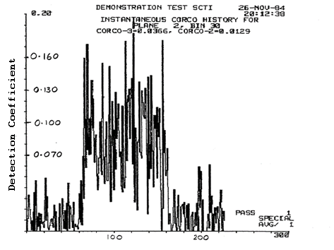
  BatScan System Performance
Depends upon five parameters:
  S/N ratio
  False alarm rate
  Detection time
  Volume monitored
  Cost (e.g. number of sensors)
Notes:
These parameters are all inter-dependent, so any test validating the performance of the BatScan system must be conducted on an entire system.
The chart on the left shows a full-system validation of the BatScan system; a fault detected in a full-sized steam generator under full power operating conditions. (Note: this test was performed and monitored by plant operators). The chart shows the detection parameter as a function of time, and start and finish of the injection of water into liquid sodium is very obvious. Multiple high levels of the detection parameter provides the data for estimating the false alarm rate.

Slide 6
BatScan System Development
BatScan Physics Models
Simulator Platform
Develop, design & optimize BatScan
Software/DSP requirements
Hardware system requirements
Hardware platform design
Software implementation
(LabVIEW)
Notes:
This slide summarizes the BatScan System. I am often asked “how does it work?”. There is no convenient, short description. It is a complex integration of many individual parts. Each part contains many models or subsystems; all of these were extensively developed and designed to integrate into a stable, accurate monitoring system. Without this attention to all aspects of its design and operation it does not work; the integration and interaction between all its parts is critical. Then its operations and parts were validated and verified against performance and operational requirements.
Think of BatScan as an airplane; without wings, engines, control surfaces, and a multitude of other subsystems it might not fly!

Slide 7
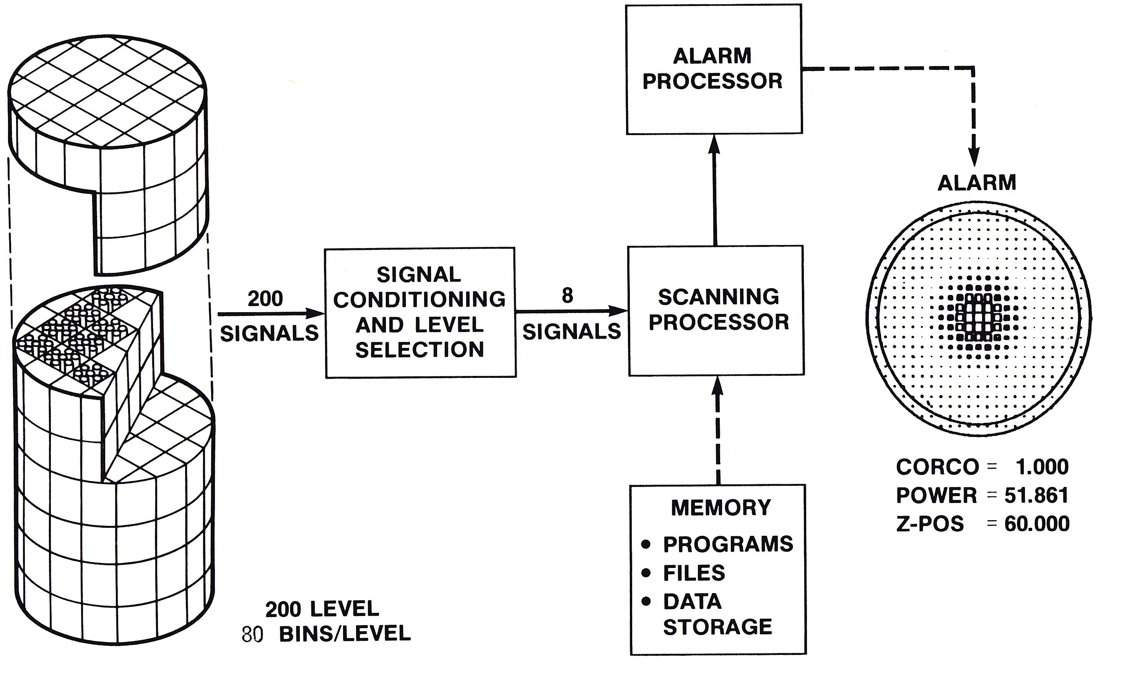
Hardware/Software Operator Platform
Platform outcome: PLiM Databases
Diagnostic/Prognostic
  Meet regulatory requirements
Notes:
If the pilot can’t fly the plane it won’t be used. BatScan hardware and operations must be matched to allow the plant operator to control the power plant safely, efficiently and effectively.
Note: BatScan mitigates damage propagation. Location of vibration or fault condition is predicted as well as damage. This can significantly reduce repair costs and optimize time to return plant to full power operation.
The BatScan system is not only for locating faults, but additionally populates databases for long-term diagnostic and prognostic investigation of plant operation. These databases are required by regulatory organizations when the plant operator wants to extend the life of the plant. They provide, for example, information used to estimate long-term fatigue damage of components.

Slide 8
Block Diagram of Simulator Software
Model Physical Configuration
Geometry of Steam Generator
Process Variables at Full Power
  Fluid Flows
  Pressures, etc.
Model Internal Processes
Thermal Hydraulic Process Model
Fluid flow velocities in the steam generator
Predict background noise caused by fluid flows
Data Acquisition and Analysis
Accelerometers
Impacts within tubes
Gentle tube tapping
Frictional noise - tubes scraping on supports
Model and DAQ Combine
Subtract background noise
Intensity of vibration caused by impacts, taps,
and scraping
Location, position of vibration
Notes:
As a further analogy to a plane, having a simulator is essential to optimize both the plant protection and damage mitigation and operator performance.

Slide 9
Block Diagram of Simulator Software (cont.)
Defines Future Needs/Actions
Limits follow-up testing to identified locations
Integrate intensity and duration is condition indicator
Operator display allows tuning of system to avoid impacting operation
Trend over time offers remaining useful life calculation
Outcomes
Provide design requirements specification
Enhance Operator understanding of plant

Slide 10
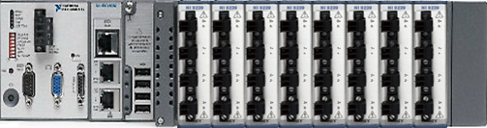
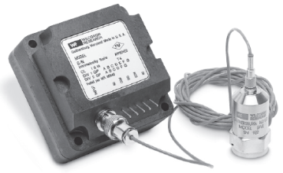
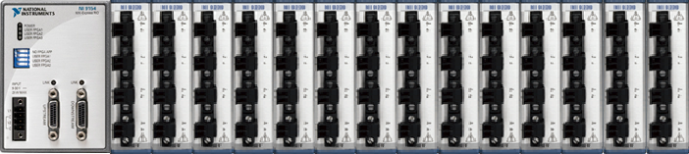
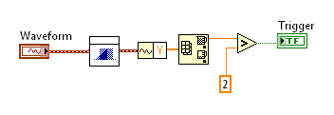
NI CompactRIO Systems Architecture
Store and Forward
Triggers on
fault indication
Map intensity fields
and peak locations
Charge sensitive
Accelerometers
Record at predetermined intervals:
Time
Waveforms
Calculations
Meta data
NI 9239: 144 24 bit high impedance analog inputs
(greater than 100db dynamic range: SFDR ~ 128db FS)
[S/N ratio range of -2 dB to -25 dB in normal operation]
Notes:
BatScan requires NI support and partnership to provide global, 24x7x365 services to power plants, both nuclear and fossil fuel, of hardware and software services. NI’s Preston Johnston will provide further information on GRDI’s BatScan and NI‘s LabView partnership.

Slide 11
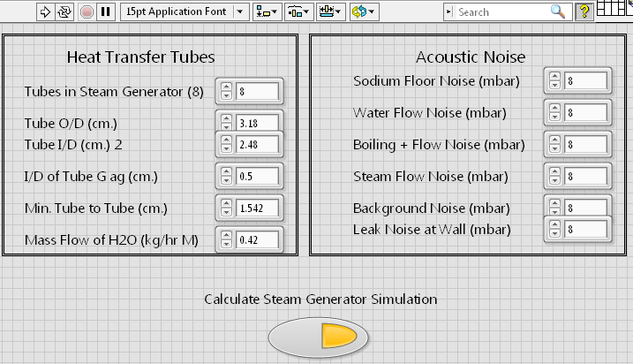
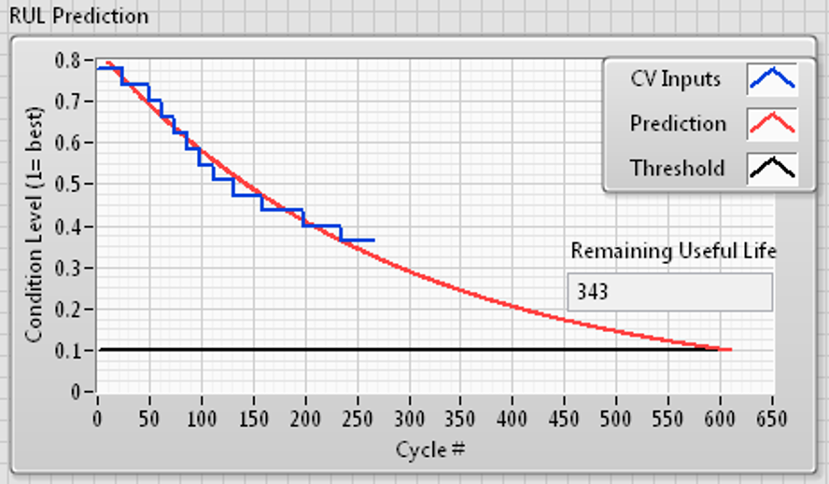
LabVIEW: Human Interface Examples
Partial Configuration GUI
Calculation of Health Indication and
Remaining Useful Life (RUL)
Notes:
Shown are typical user interfaces that could be created as part of an implementation of the BatScan system. The interface on the left is demonstrating entry of parameters into a steam generator simulation, and the interface on the right shows an example chart of remaining component life.

Slide 12
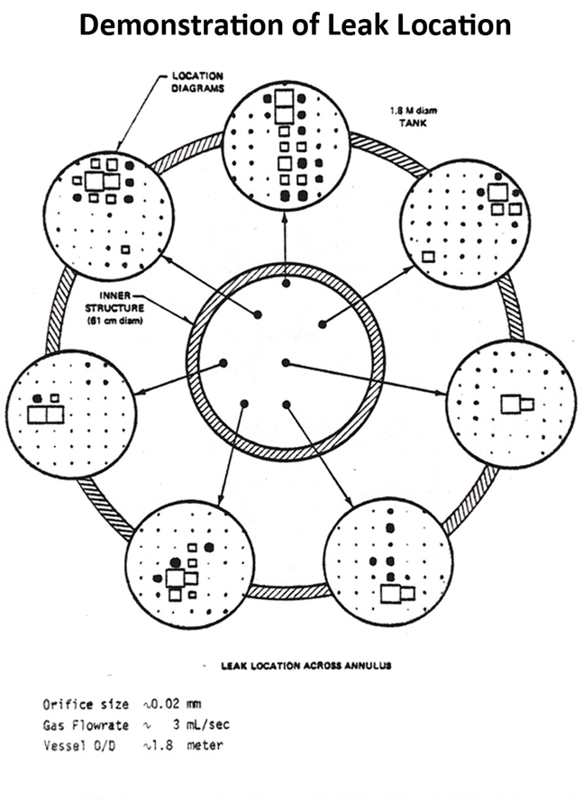
BatScan Simulation Demo
Video
Notes:
Click the link to view the video demonstration
http://www.grdi.com/media/BatScanDemo.mp4

Slide 13
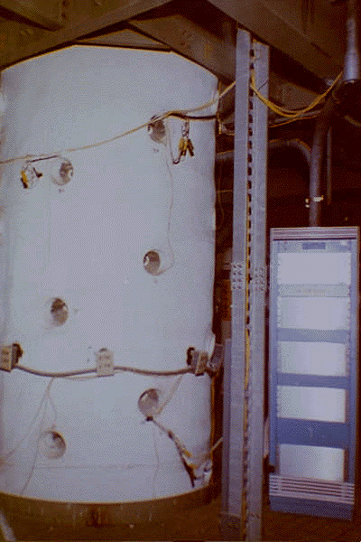
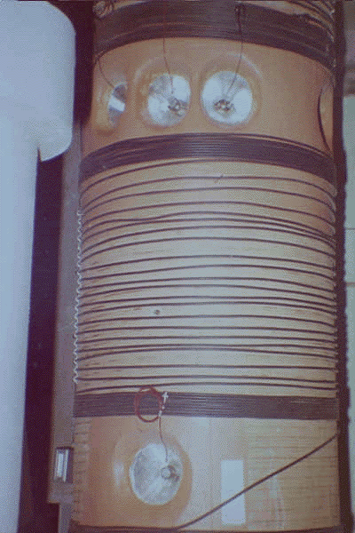
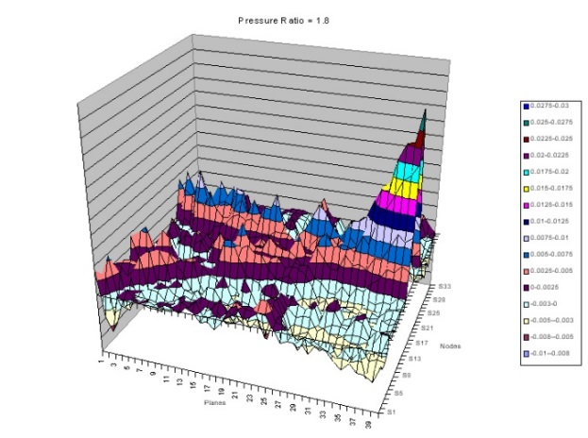
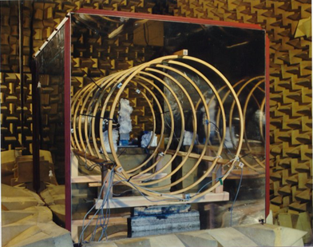
Real-world Implementation and Industrial experience (Verification and Validation)
  Many previous installations
  Cost effective technology
  BatScan technology is essential for economic and regulatory success
SCTI
EBR II
NASA
British Aerospace
Notes:
Conclusion:
Southern California Edison could have resolved this problem, but it appears that business-related factors strongly influenced the decision to close the plant, independent of the closure’s impact on California and wholesale electricity costs.
The designer/manufacturer of the new SONGS steam generators, Mitsubishi Heavy Industries, provided a solution to the vibration phenomenon by operating the plant at a 70% power level. The NRC refused to allow this operation mode without adequate proof that the steam generator could operate safely. SCE was unable to provide that proof. BatScan could have provided the required protection!

Slide 14
Q&A
Contact Information:
  Dr. Rosemary Greene, GRDI Rgreene@grdi.com www.GRDI.com
  Preston Johnson, NI
  Preston.Johnson@ni.com
  Tomorrow’s Technology Today
Notes:
Inquiries can be sent to Rosemary Greene, rgreene@grdi.com

